Slide 1
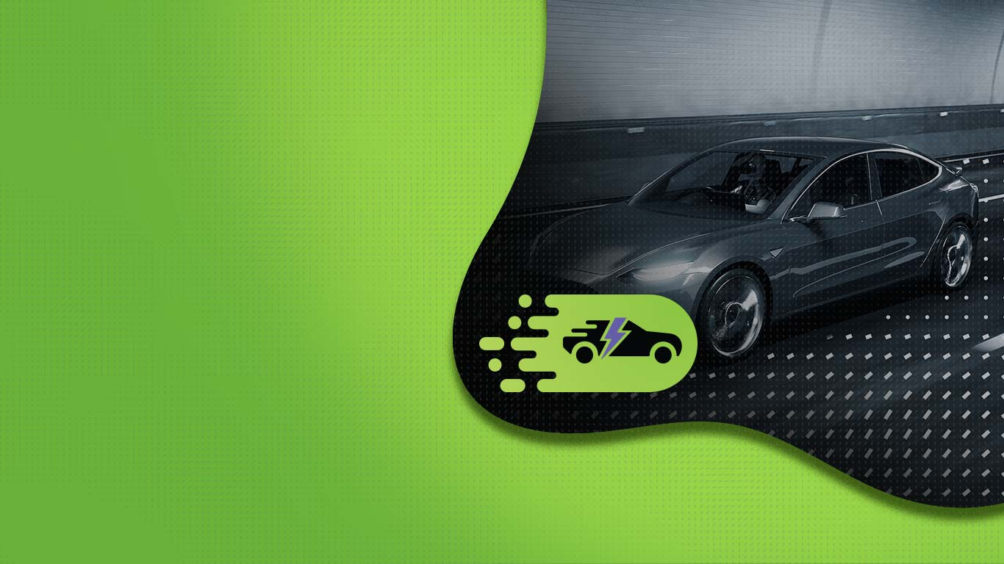

Sparkle.kpit.com
2020
SPARKLE ID : SP20I002899

Slide 2
SPARKLE ID : SP20I002899
Wireless charging of EV's battery system from RF sources by using Rectenna methodology
Presented by :
Somnath Dutta
Kislay Anupam
Madhurya Barman
Sasanka Medhi

Slide 3
Background of project
Distance wireless charging using radio frequencies has the potential to replace other charging methods because it is more efficient and it can charge multiple electric vehicles simultaneously.
In the current method of wireless charging the device needs to be in a very close range to the source and charges one vehicle at a time. Our developed technology has managed to solve these problems and takes lesser time to charge.

Slide 4
Problem Statement
Present situation and development of technology are the evidence that in coming years there will be huge use of Battery Operated Vehicles (BOV). So, the following issues need to be addressed:-
Wired charging only allows us to charge single vehicle at a time.
The present charging system is very inconvenient due to the use of cables and adapters.
The cars are fitted with heavy /expensive batteries.

Slide 5
Solution
Keeping the present scenario of electric vehicle’s charging system in mind we have developed our own rectenna based device, which generates electricity in the presence of radio waves from 2.8 GHz to 68.63 GHz. Which will not only wirelessly charge electric vehicles from a distance, but we will also remove the use of cables and power adapters.
With the help of this distance charging, we can charge multiple electric vehicles simultaneous using only single RF source.
Establishing this technology on roads and highways will provide never ending charge while driving. This will shrink the size of batteries and will improve the car's performance on roads.

Slide 6
Innovation
We have designed and developed a rectenna based device, which has made it possible and convenient to wirelessly charge multiple electric vehicles simultaneously in a range of 2-8 meters using radio frequencies as source.
We have developed photonic transceiver to gain electromotive charge particle from distance source.
We have developed nonferrous metal alloys antenna, in which rectenna gain power increased up to 47.64 percent.

Slide 7
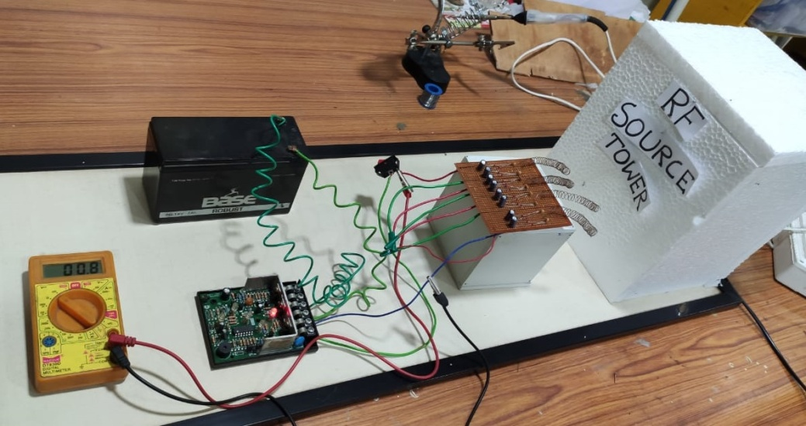
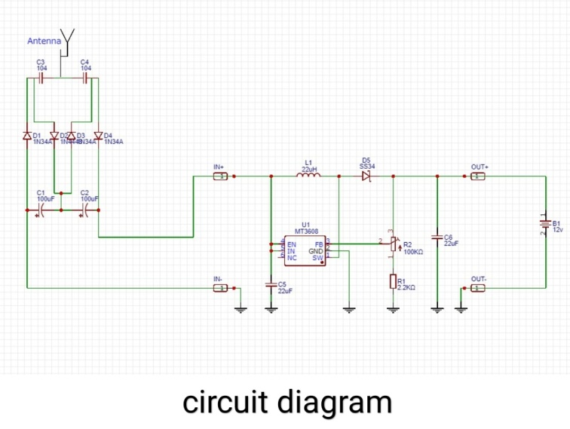
Product Description
We have designed a rectenna based device which has made it possible and convenient to wirelessly charge multiple electric vehicles simultaneously from distance, in a range of 2-8 meters using radio frequencies from 2.8 GHz to 68.63 GHz as source. We have also developed photonic transceiver to gain electromotive charge particle from distance source to charge 12 volt battery with rated current .

Slide 8
THANK YOU
Sparkle.kpit.com

